Slide 1
Anisotropic adaptive mesh coarsening and refinement on GPU architecture
Matthew Potter
Supervisors
Gerard Gorman
and Paul H J Kelly
Department of Computing
Imperial College London

Slide 2

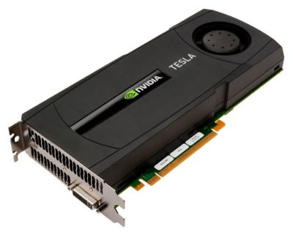
GPGPU – General-purpose computing on graphics processing units
2 x Xeon X5650
12 core, 10.7 GFLOPS per core
128 GFLOPS
1 x Tesla C2050
520 GFLOPS

Slide 3
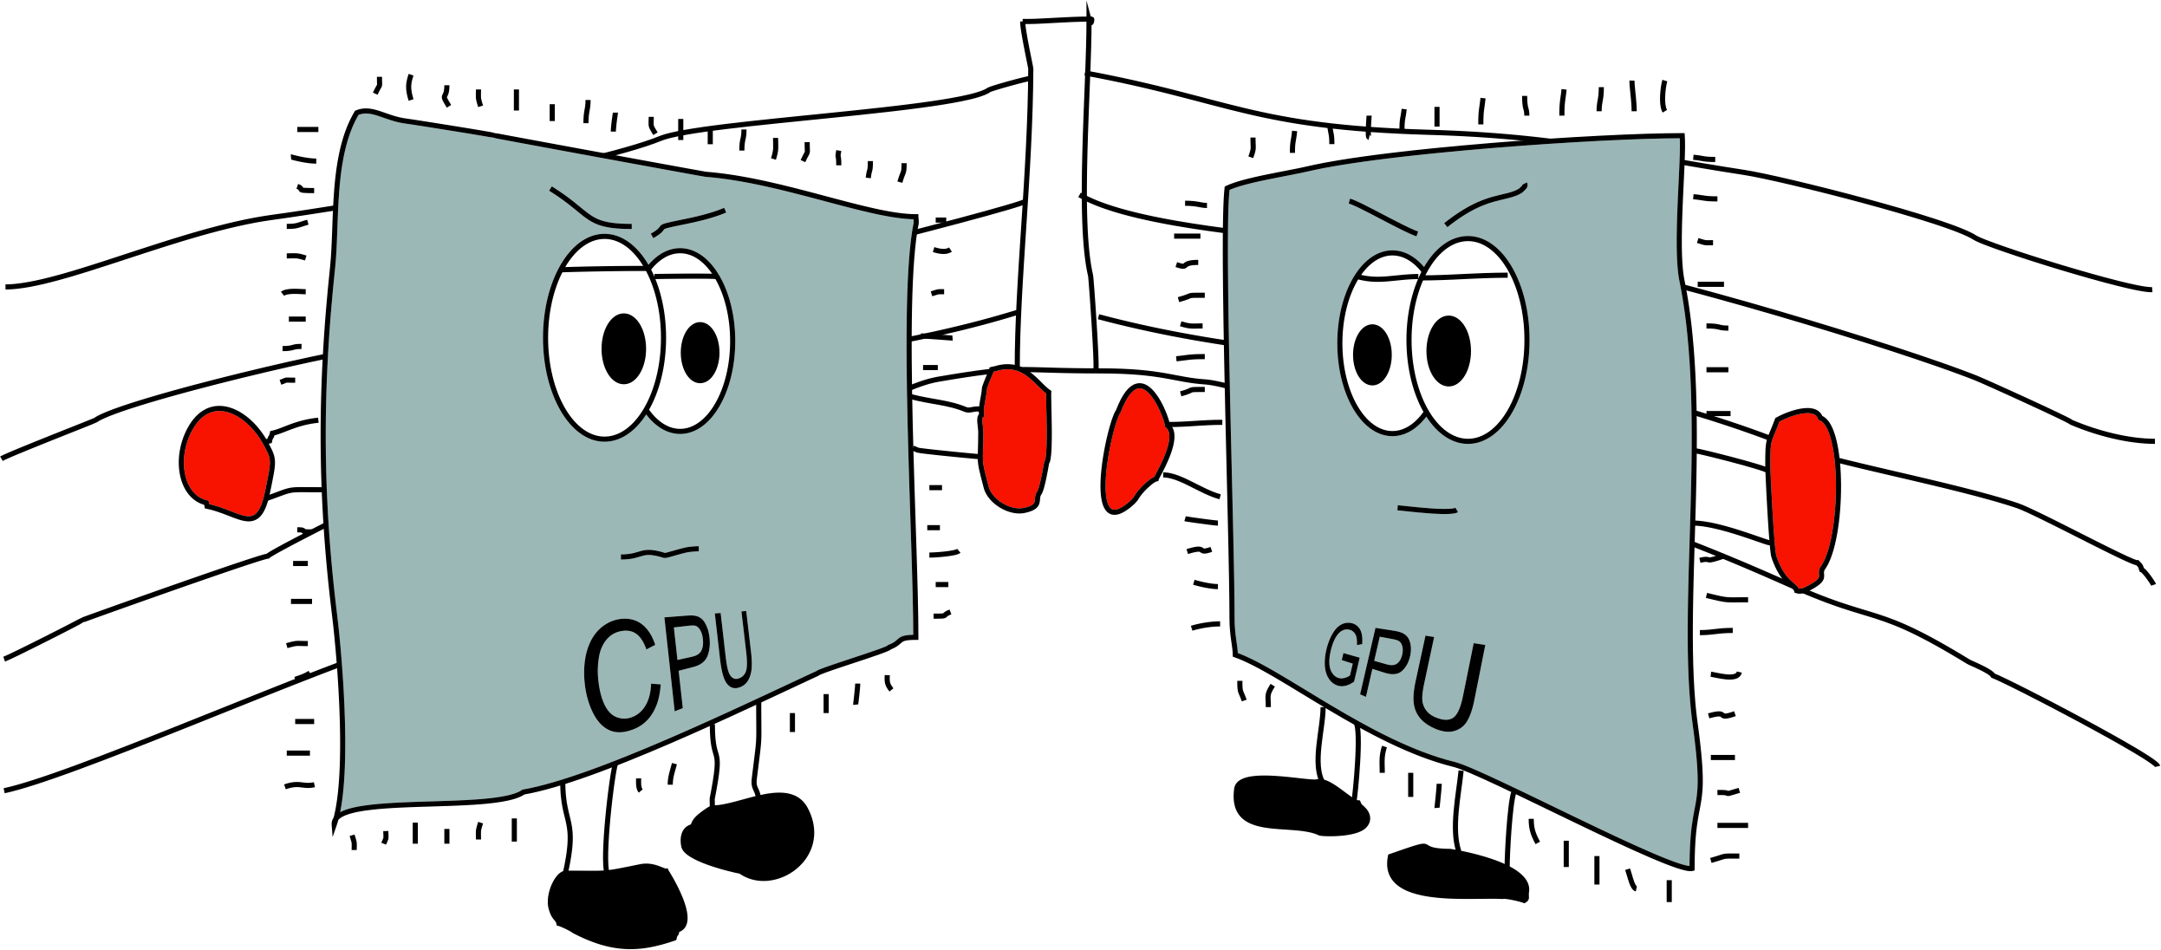

Slide 4
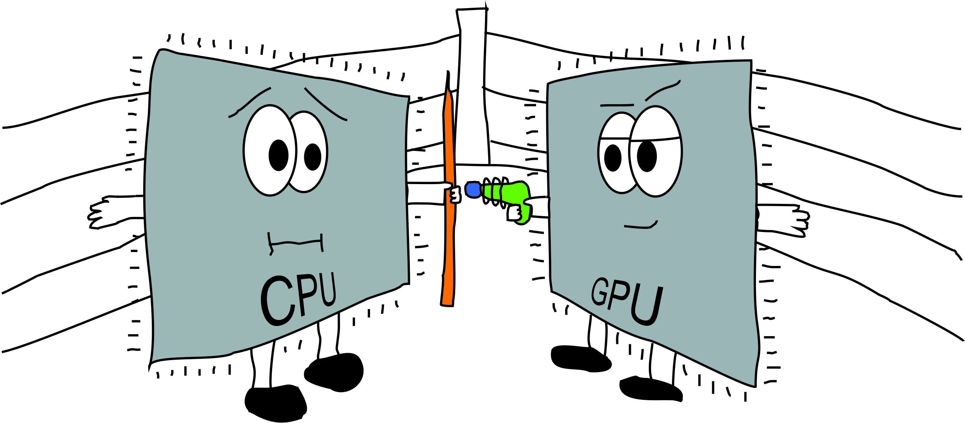

Slide 5
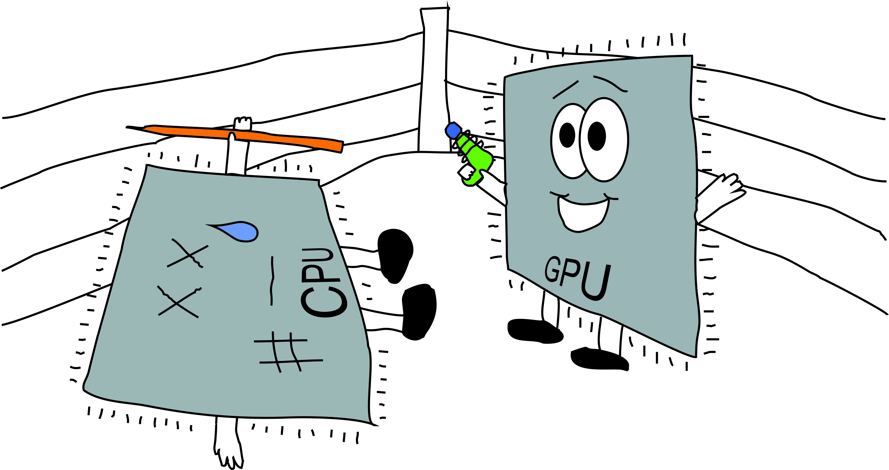

Slide 6


Slide 7
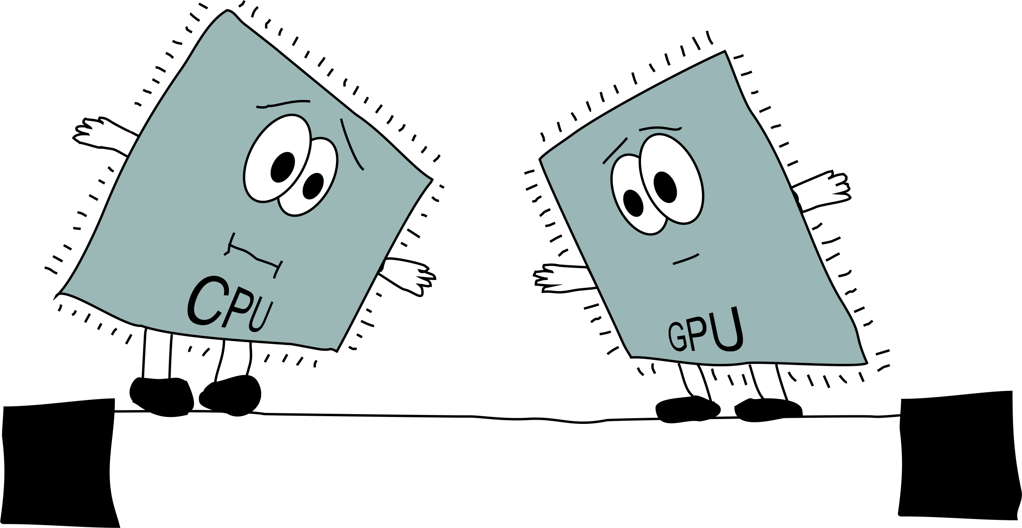

Slide 8
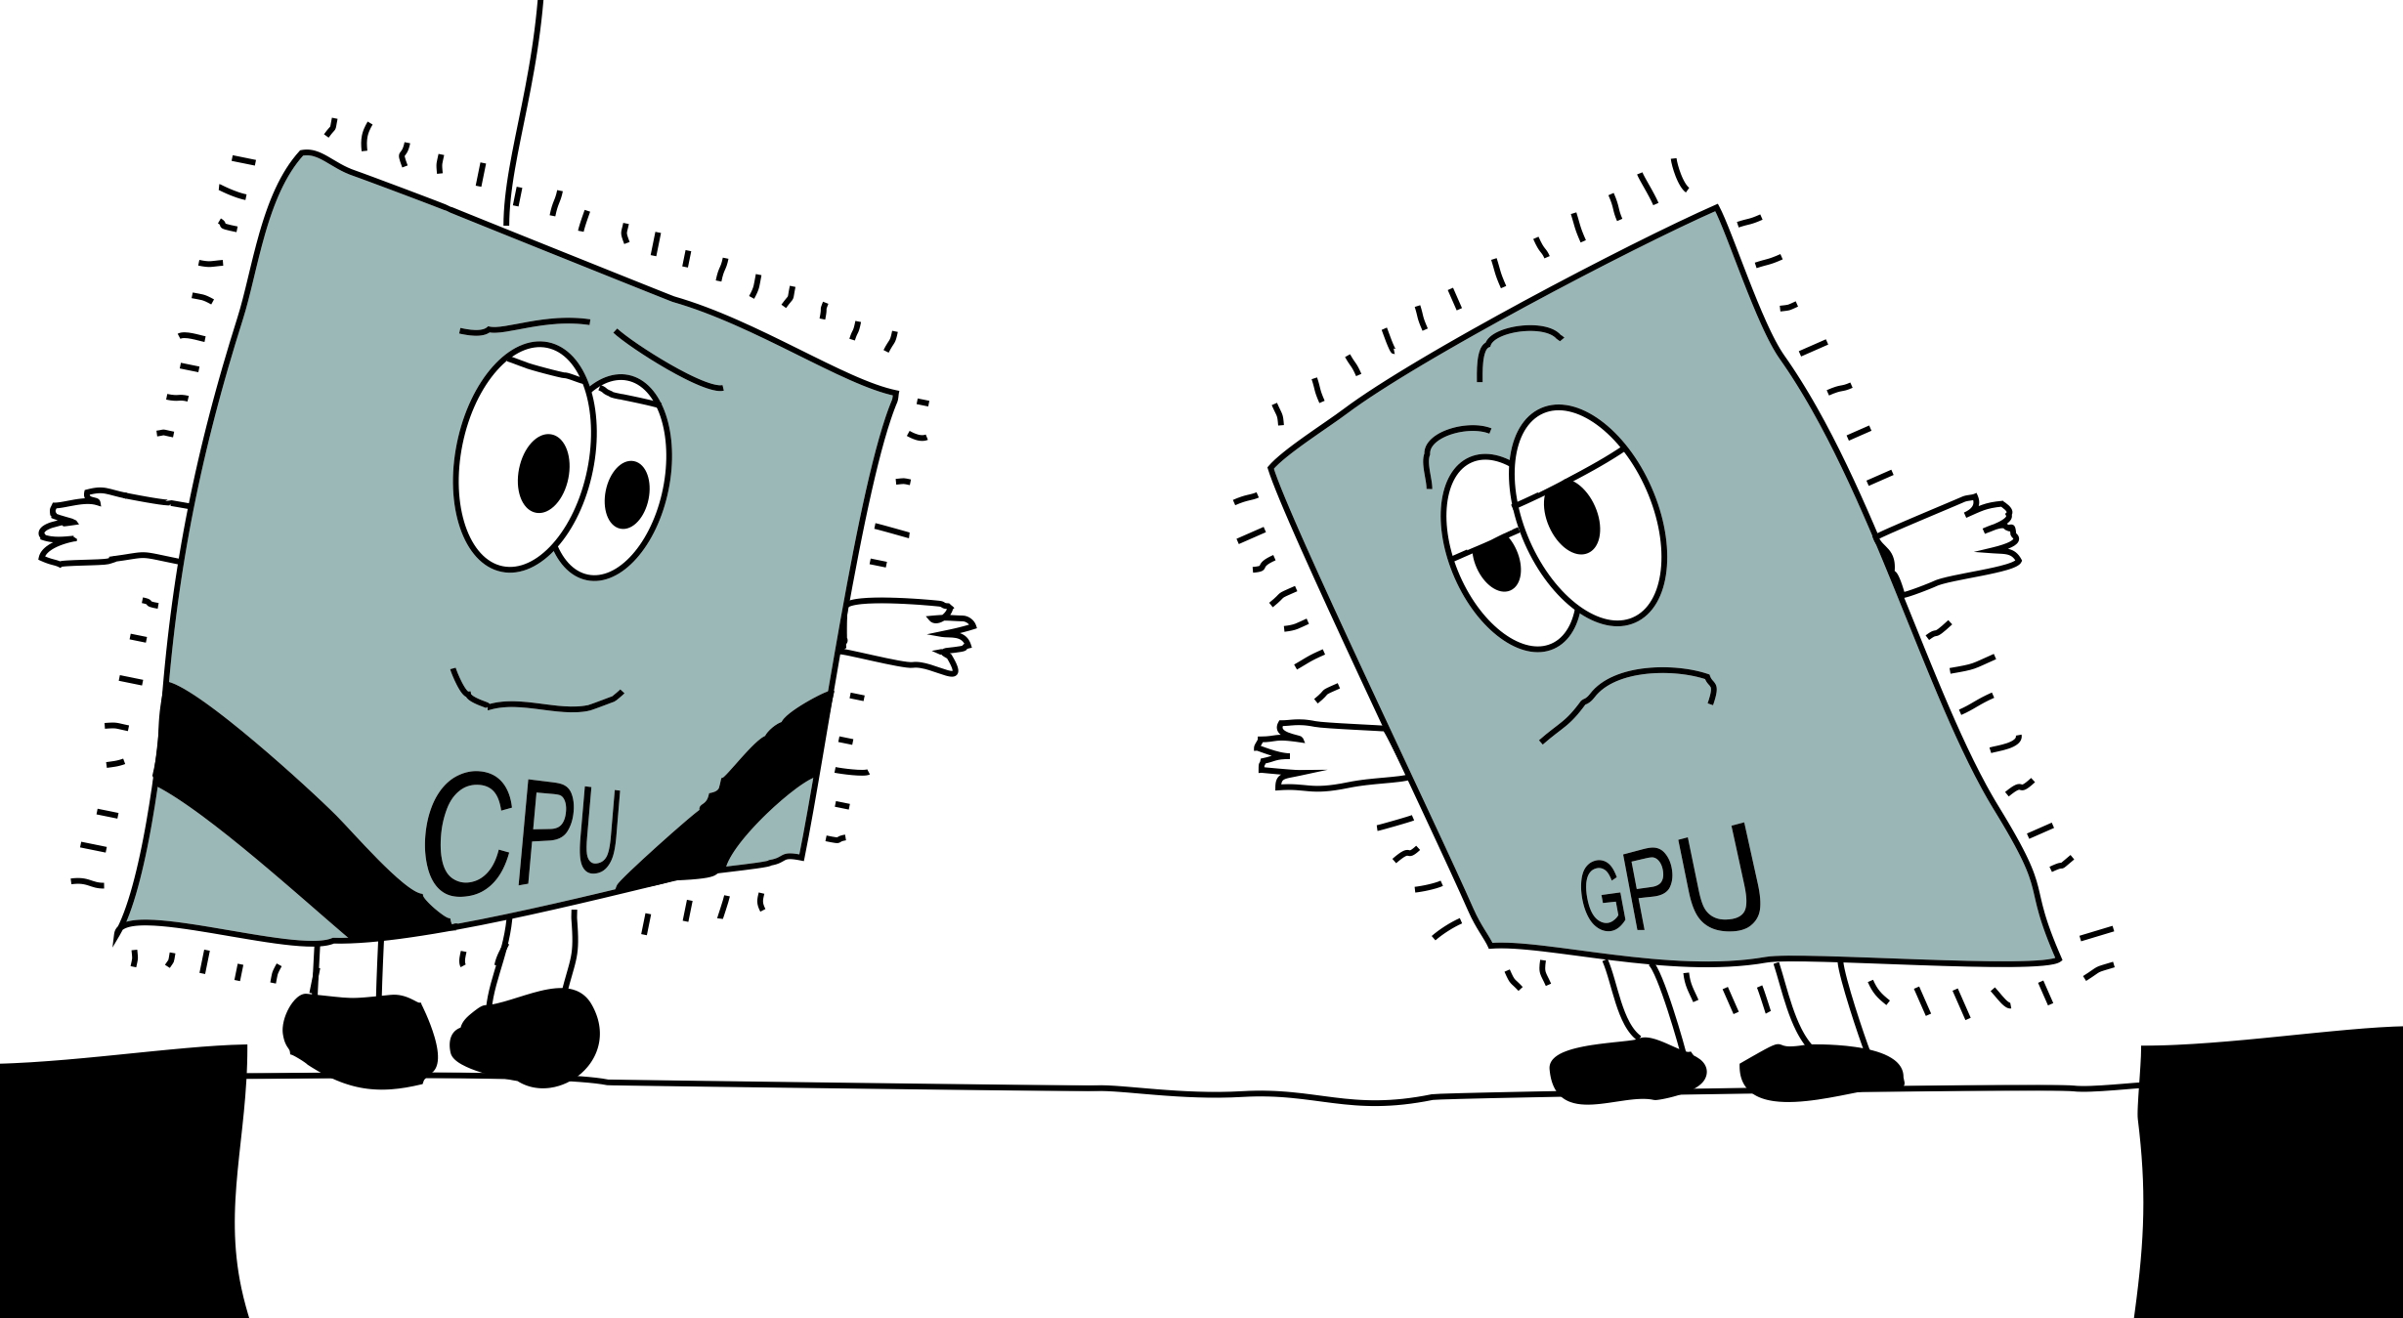

Slide 9
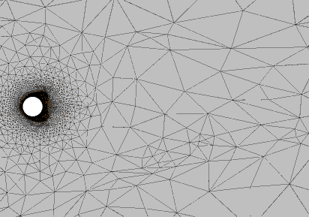
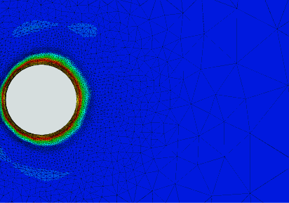
Mesh adaptivity
Flow past a heated cylinder
  Provided by Imperial Applied Modelling and Computation Group (AMCG)
Notes:
Mesh adaptivity is computationally expensive
Need for parallel implementations
Previous work: CUDAMesh64
Mesh smoothening - Georgios Rokos
15x speedup over optimised CPU version
Not just another GPGPU project
Unstructured data
Irregular memory access
High thread divergence
Computational fluid dynamics
Based on Navier-Stokes PDEs
Numerical solution using unstructured meshes
Discrete form of domain of interest
Triangular (2D) and tetrahedral (3D) shape
Mesh quality
Adapt mesh to within user specified bounds
Metric to determine error depends on type of adaptivity

Slide 10
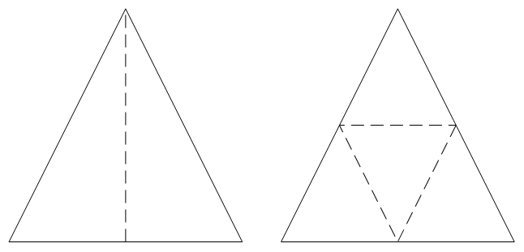
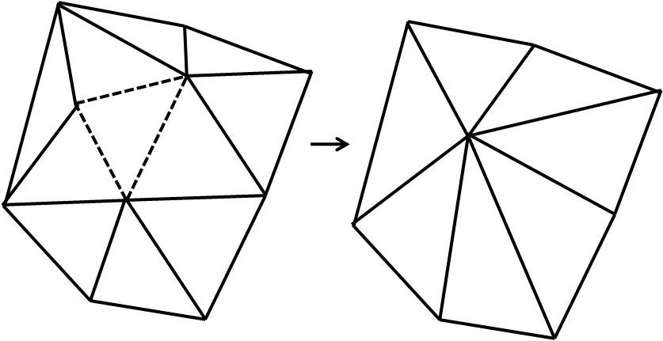
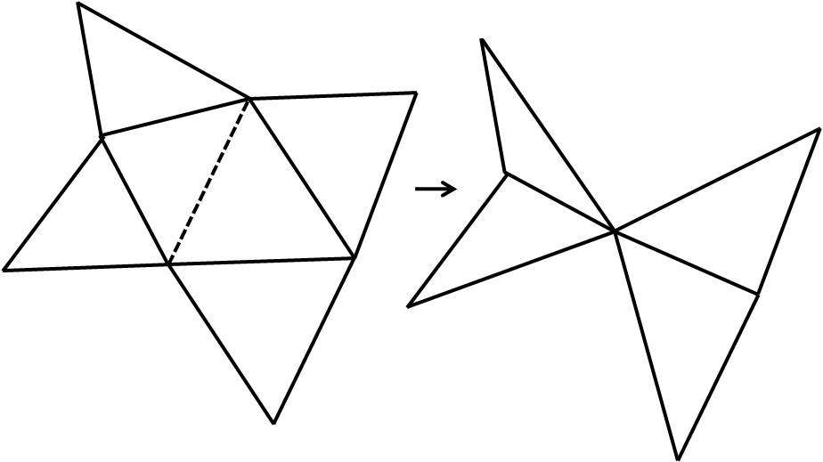
Adaptive algorithms - Refinement and coarsening
Adaptive refinement
  Element bisection
  Regular refinement
    Isotropic refinement
Adaptive coarsening
  Element collapse
  Edge collapse
  Can be combined with regular refinement to produce anisotropic results

Slide 11
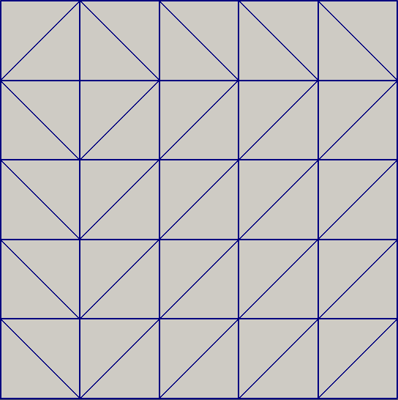
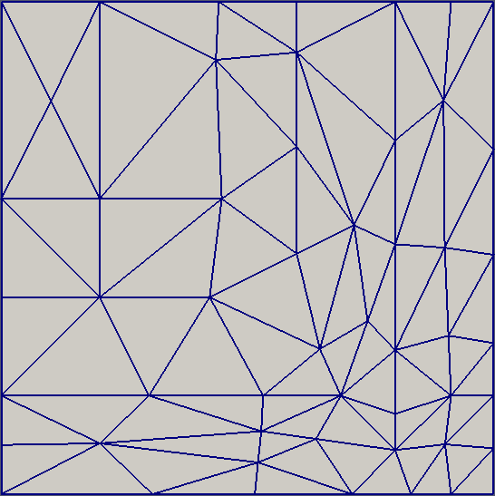
Adaptive algorithms - Refinement and coarsening
Original mesh – 50 elements
Adapted mesh – 70 elements

Slide 12
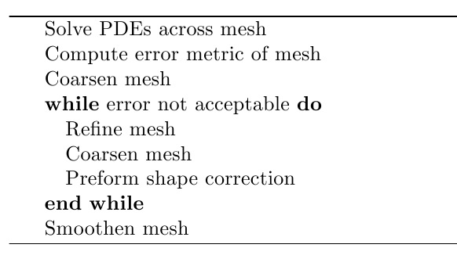
Adaptivity framework
Proposed by Shephard et al – Rensselaer Polytechnic Institute, Troy New York 2004
Overall mesh adaptation procedure

Slide 13
Adaptivity framework
Proposed by Shephard et al – Rensselaer Polytechnic Institute, Troy New York 2004
Overall mesh adaptation procedure

Slide 14
Data structures
Vertex
  2D vertex co-ordinated
Element
  3 x Element vertex ID
  3 x Adjacent element ID
No Edges
No vertex-element adjacency
Elements
Vertices

Slide 15
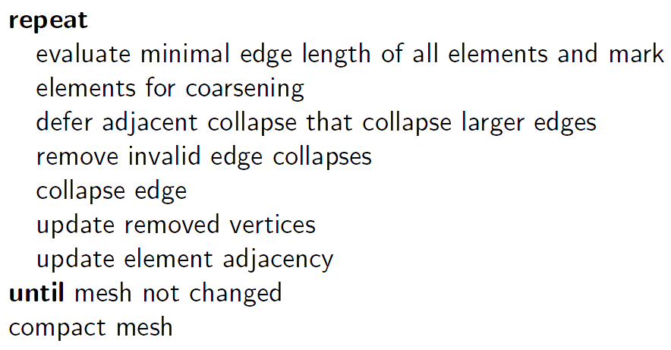
Design - Coarsening
Edge collapse

Slide 16
Design - Coarsening
-1

Slide 17
Design - Coarsening
-1

Slide 18
Design - Coarsening
-1

Slide 19
Design - Coarsening
2.9

Slide 20
Design - Coarsening
2.9

Slide 21
Design - Coarsening
2.9

Slide 22
Design - Coarsening
2.3

Slide 23
Design - Coarsening
2.3

Slide 24
Design - Coarsening
2.3

Slide 25
Design - Coarsening
2.3

Slide 26
Design - Coarsening
2.3

Slide 27
Design - Coarsening
2.3

Slide 28
Design - Coarsening
2.1

Slide 29
Design - Coarsening
2.1

Slide 30
Design - Coarsening
2.1

Slide 31
Design - Coarsening
1.9

Slide 32
Design - Coarsening
1.9

Slide 33
Design - Coarsening
1.9

Slide 34
Design - Coarsening
2.0
3.5
1.9
2.1
2.3
1.9

Slide 35
Design - Coarsening
-1
-1
1.9
-1
-1
1.9

Slide 36
Design - Coarsening
-1
-1
-1
-1
-1
1.9

Slide 37
Design - Coarsening

Slide 38
Design - Coarsening
Defers collapse of adjacent vertices marked for removal on vertex graph
Algorithm avoids the need to store and maintain edges explicitly
Algorithm avoids the need to store and maintain vertex-element graph, this is inferred during execution
Single reallocation of memory

Slide 39
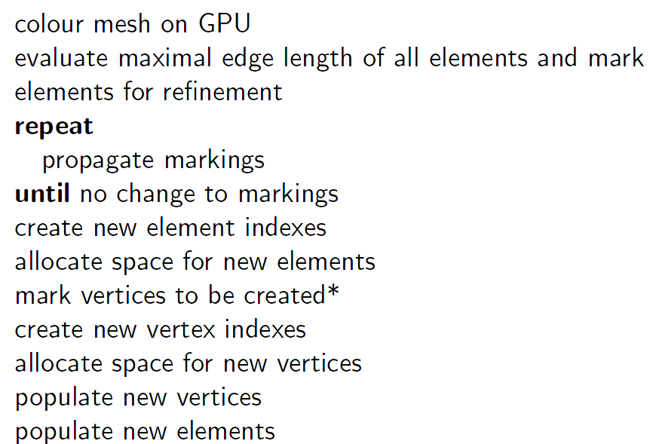
Design - Refinement
Regular refinement based on Banks' algorithm – IMACS/North-Holland 1983

Slide 40
Design - Refinement
Regular refinement based on Banks' algorithm – IMACS/North-Holland 1983

Slide 41
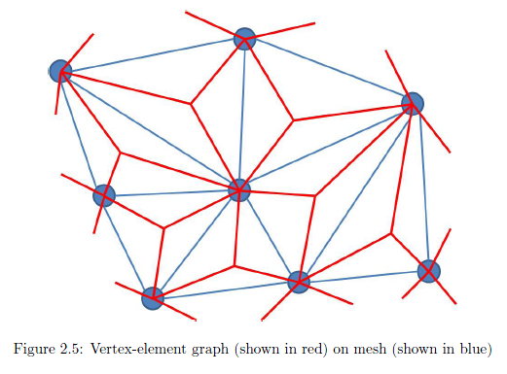
Backup slides

Slide 42
Design - Refinement
3
9
1
6
2
7

Slide 43
Design - Refinement
3
9
1
6
2
7

Slide 44
Design - Refinement
3
9
1
6
2
7

Slide 45
Design - Refinement
3
9
1
6
2
7

Slide 46
Design - Refinement
3
9
1
6
2
7

Slide 47
Design - Refinement
Regular refinement based on Banks' algorithm – IMACS/North-Holland 1983

Slide 48
Design - Refinement
Regular refinement based on Banks' algorithm – IMACS/North-Holland 1983

Slide 49
Design - Refinement

Slide 50
Design - Refinement

Slide 51
Design - Refinement

Slide 52
Design - Refinement

Slide 53
Design - Refinement

Slide 54
Design - Refinement

Slide 55
Design - Refinement

Slide 56
Design - Refinement

Slide 57
Design - Refinement

Slide 58
Design - Refinement

Slide 59
Design - Refinement

Slide 60
Design - Refinement
Regular refinement based on Banks' algorithm – IMACS/North-Holland 1983
Calculate required space
Index new items
Allocated space and populate

Slide 61
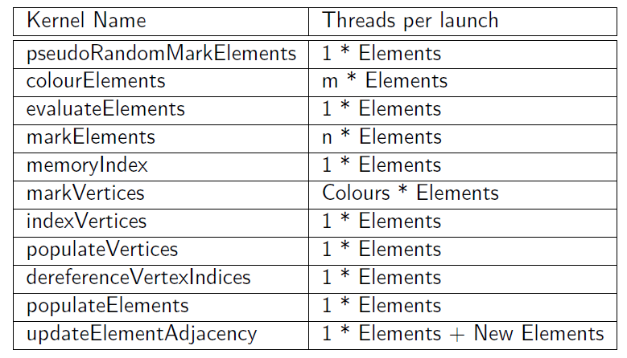
Design - Refinement

Slide 62
Design - Refinement
Fast graph colouring done on GPU
Algorithm avoids the need to store and maintain edges explicitly
Only a single kernel needs to be executed in independent sets
Single reallocation of memory

Slide 63
Lessons learnt
Lessons learnt on CUDA
Launch thousands of threads
Decompose problem to chunks which can be run in parallel
Size of L1 cache greatly affects coarsening and refinement
Pinned memory of little or no advantage
Tweaking occupancy can yield significant performance
Memory transfer times are a major issue

Slide 64
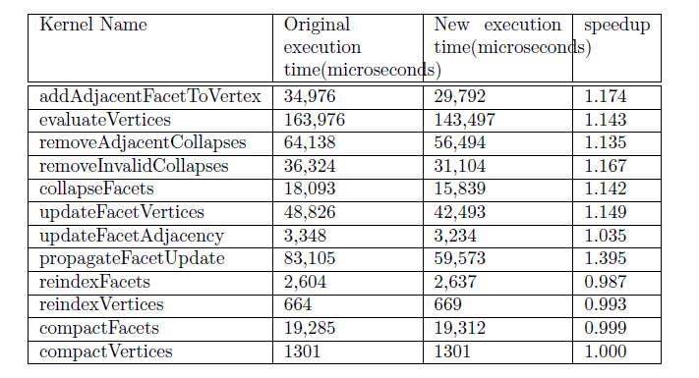
Lessons learnt
Lessons learnt on CUDA
Effect of adjusting block size for coarsening

Slide 65
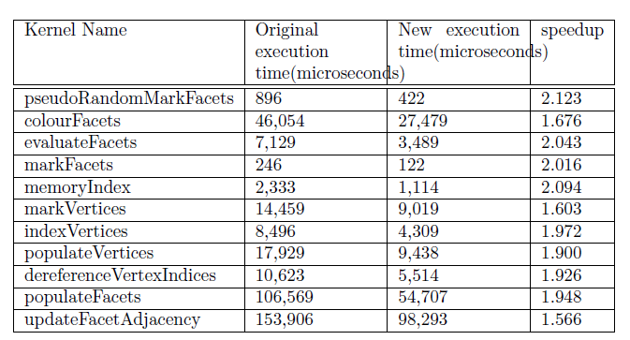
Lessons learnt
Lessons learnt on CUDA
Effect of adjusting block size for refinement

Slide 66
Results
Event | % of execution time
Copy mesh to GPU | 9.91%
Coarsening | 29.92%
Create temp data structures | 0.15%
Refinement | 23.41%
Copy mesh to CPU | 36.60%

Slide 67
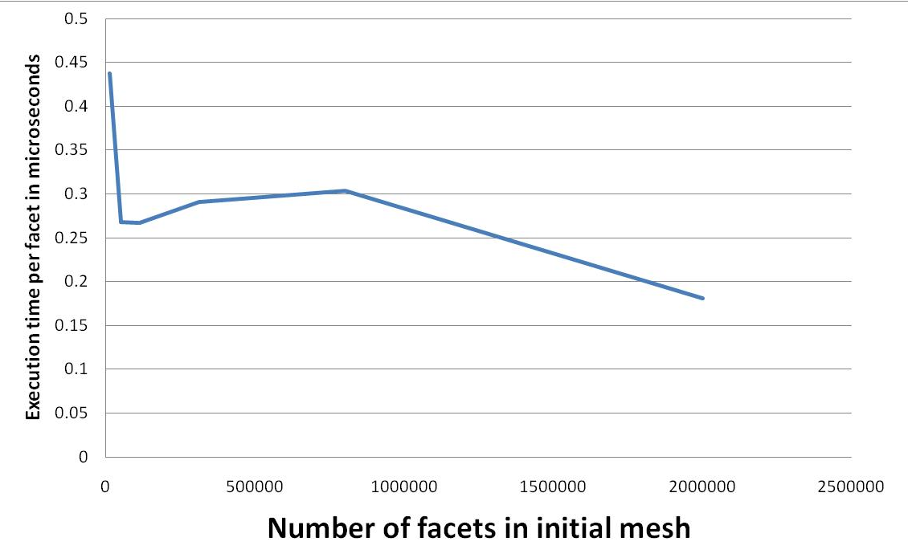
Results
Average adaptivity time across a range of meshes with a range of different error bounds. Transfer time included.

Slide 68
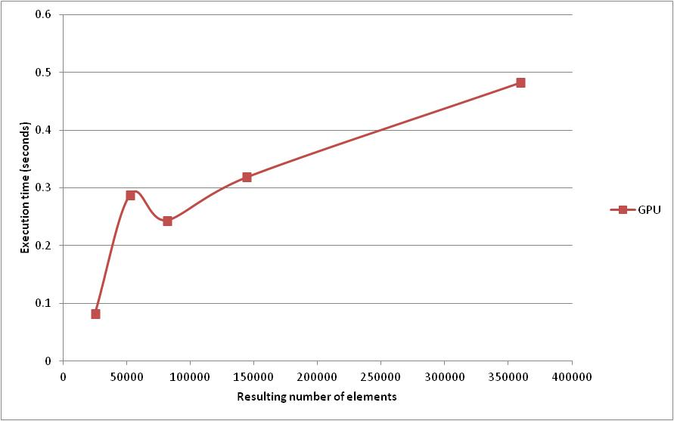
Results
Average adaptivity time on a single initial mesh (50,000 elements) across a range of different error bounds. Transfer time included.

Slide 69
Results - Coarsening
Compared against best known multi threaded CPU implementation – PRAGMATIC
Compiled using Intel compiler with –O2
12 core westmere-EP, nVIDIA Tesla C2050
Times in milliseconds
Size | CPU Time | GPU Time | GPU Speedup
140 | 1.9 | 2.8 | 0.67
12,432 | 144.8 | 9.3 | 15.54
50,142 | 677.7 | 17.6 | 38.58
112,554 | 1,569.0 | 37.7 | 41.59
313,344 | 4,531.1 | 116.1 | 39.04

Slide 70
Results - Refinement
Compared against best known multi threaded CPU implementation – PRAGMATIC
Compiled using Intel compiler with –O2
12 core westmere-EP, nVIDIA Tesla C2050
Times in milliseconds
Size | CPU Time | GPU Time | GPU Speedup
140 | 3.7 | 4.2 | 0.87
12,432 | 470.2 | 7.6 | 62.15
50,142 | 3,799.8 | 20.9 | 181.94
112,554 | 6,490.4 | 46.8 | 138.70
313,344 | 7.765.5 | 137.0 | 56.67

Slide 71
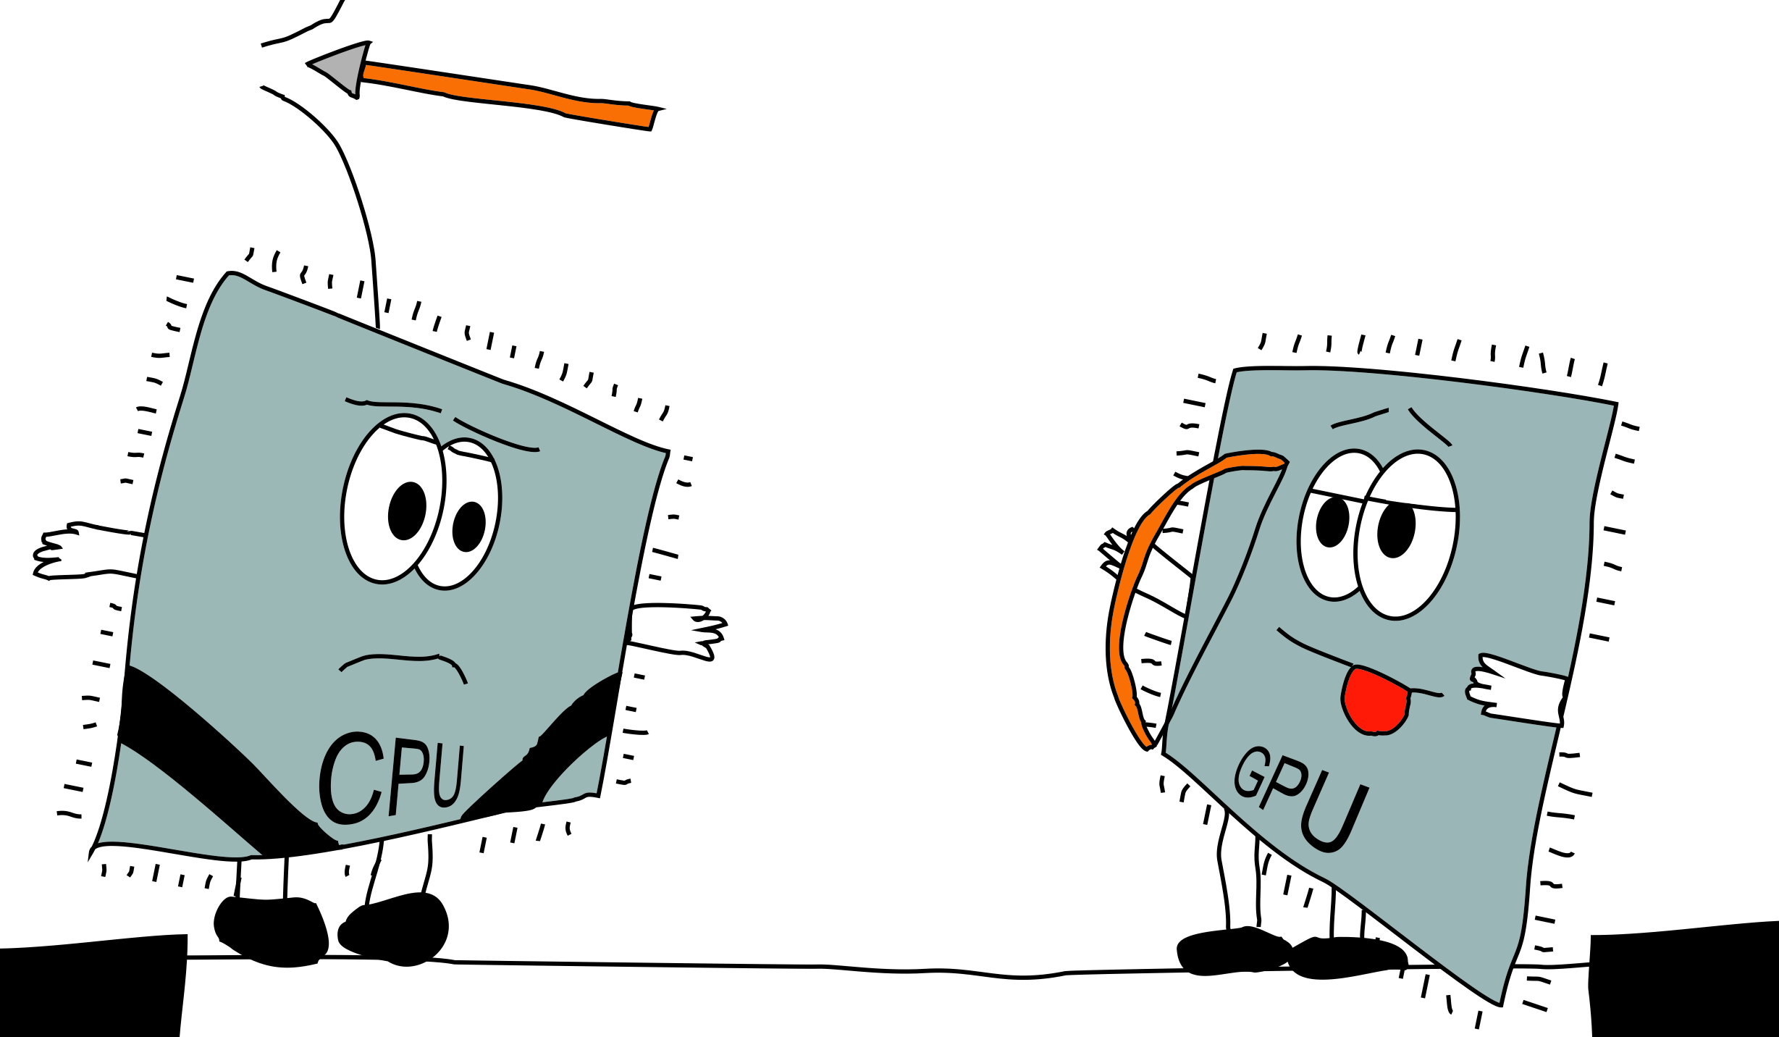

Slide 72
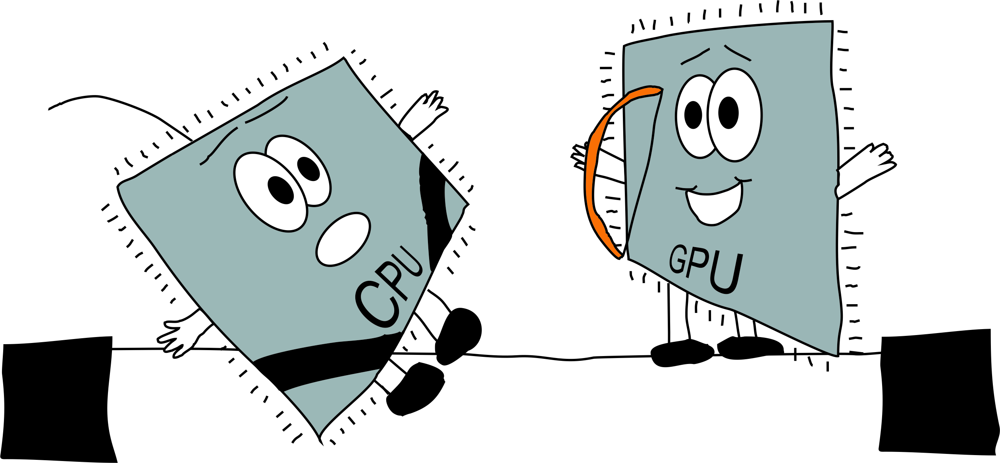

Slide 73
2 x Xeon X5650
12 core, 10.7 GFLOPS per core
128 GFLOPS
1 x Tesla C2050
520 GFLOPS

Slide 74


Slide 75
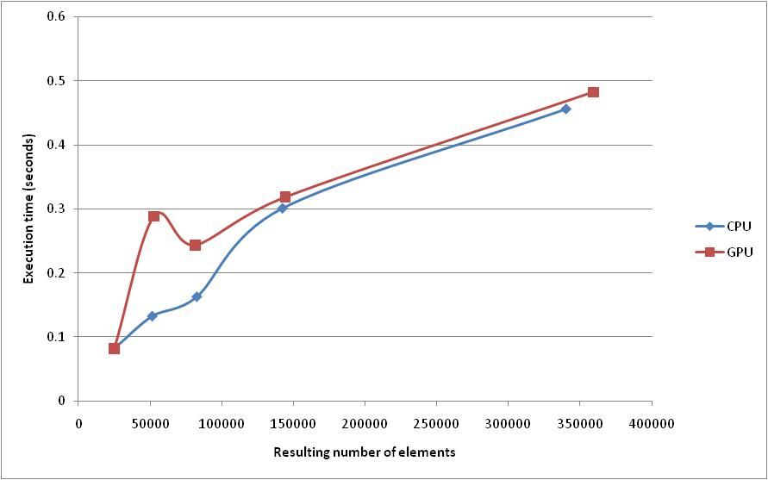
Results
Average adaptivity time on a single initial mesh (50,000 elements) across a range of different error bounds. Transfer time included.

Slide 76
Future work
Integration with PRAGMATIC
Integration with Fluidity
Shape correction
Extend to 3D
CPU implementation with SSE/AVX
CPU implementation using Cilk
Other architectures
Georgios Rokos PhD

Slide 77
Backup slides

Slide 78
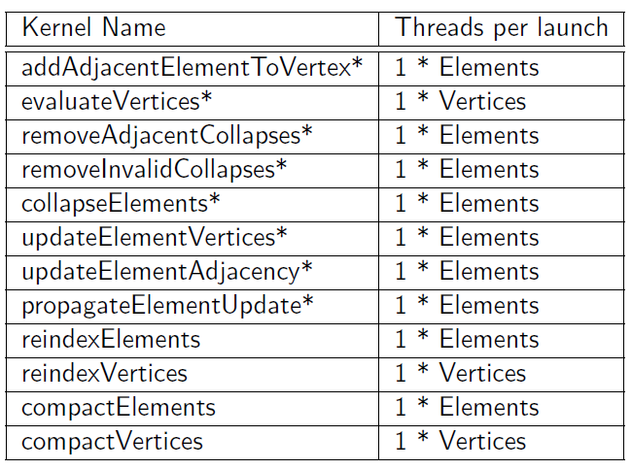
Design - Coarsening

Slide 79
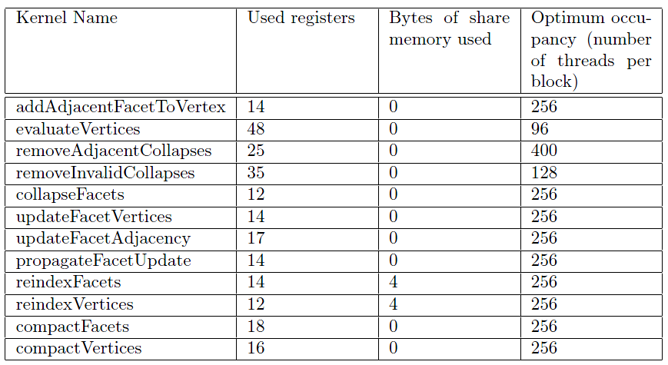
Backup slides

Slide 80
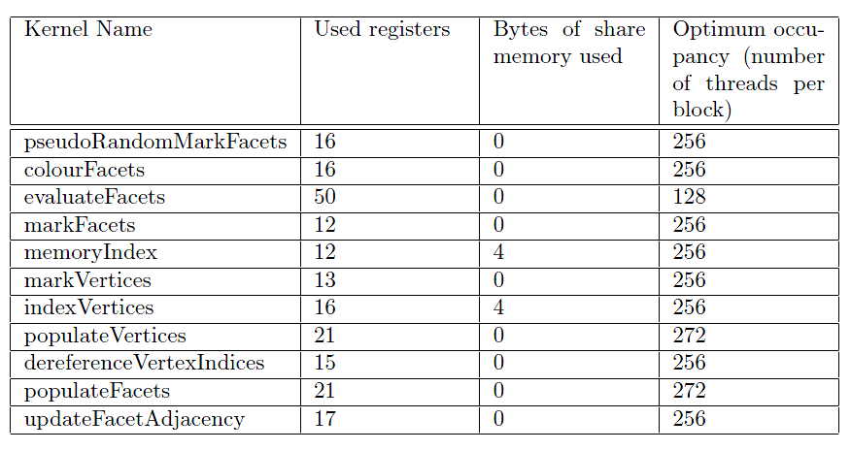
Backup slides

Slide 81
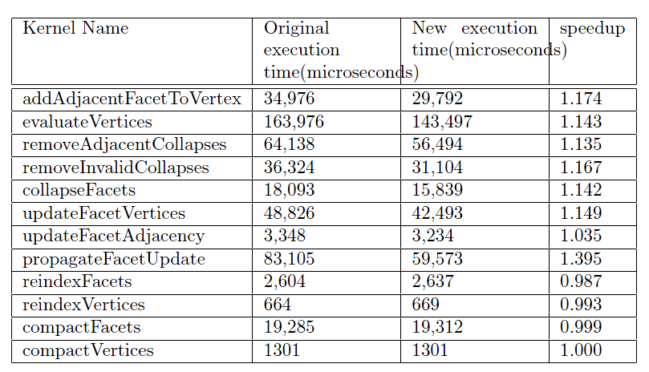
Backup slides

Slide 82
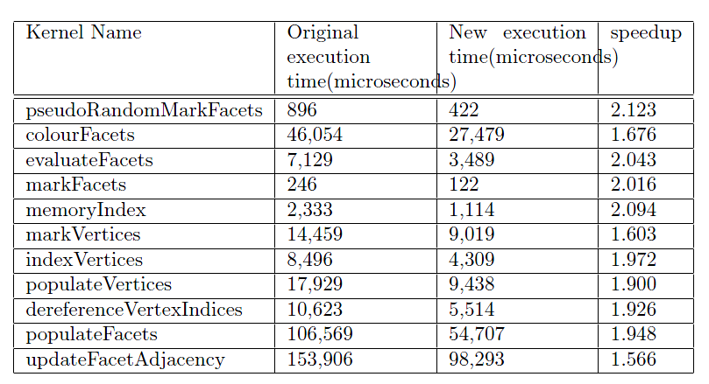
Backup slides

Slide 83
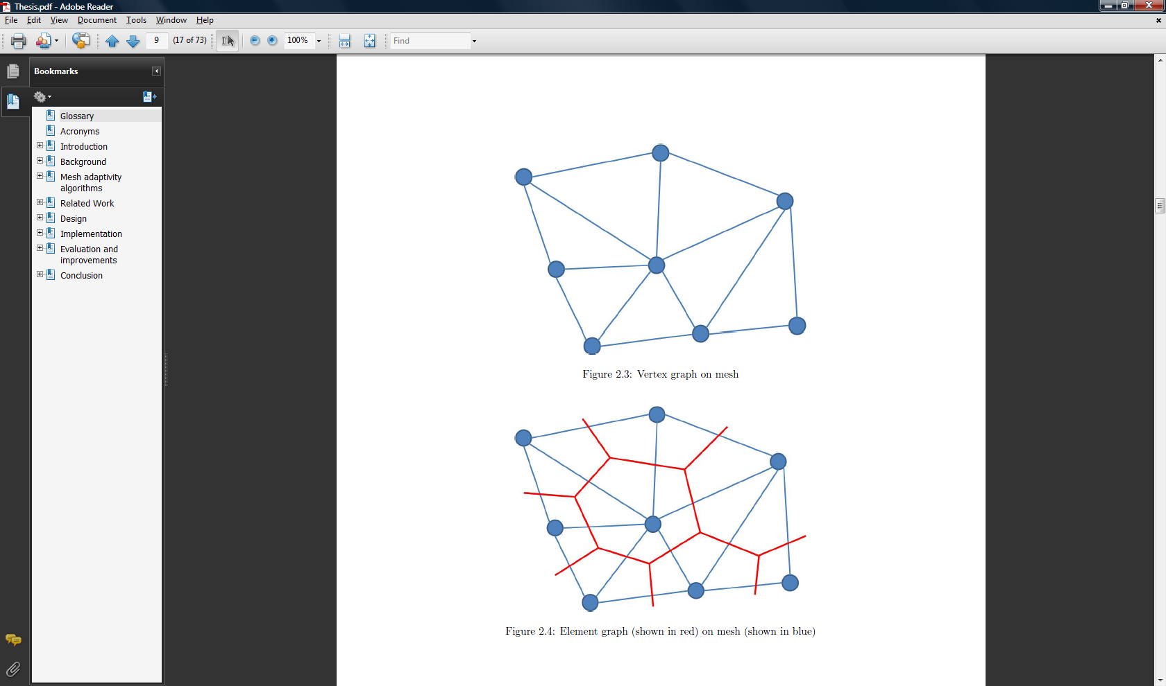
Backup slides

Slide 84
Backup slides

Slide 85
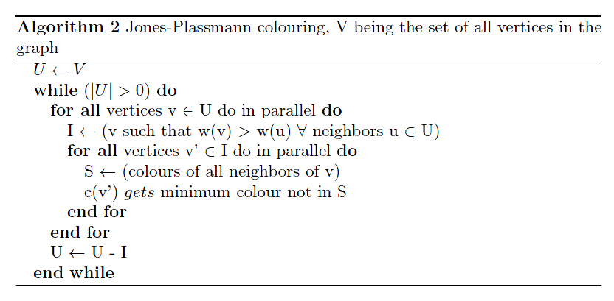
Backup slides

Slide 86
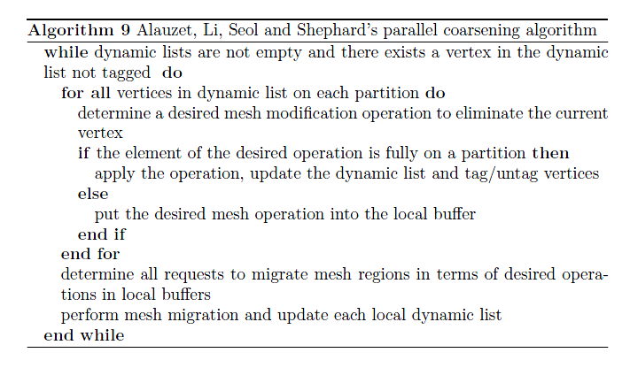
Backup slides

Slide 87
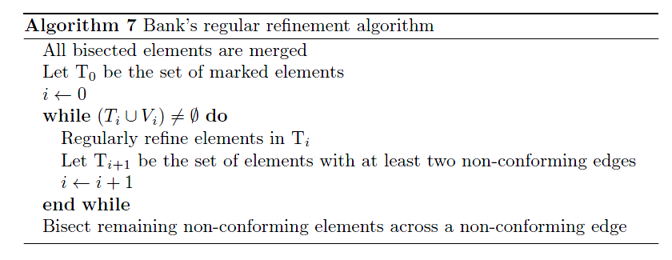
Backup slides

Slide 88
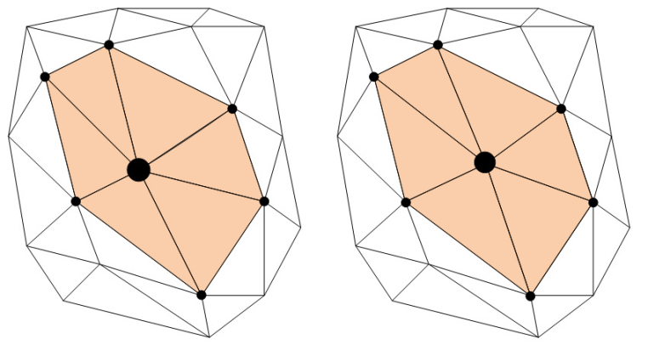
Backup slides
The most expensive technique
Relocates the free vertex of a cavity
Can be implemented using various algorithms
  Generalised Laplacian smooth described by Pain et al.
    Places the free vertex at geometric centre in metrics space
  Algorithm by Freitag et al.
    Differential method
    Based on steepest descend to find where quality is maximised
Subject of Georgios Rokos MSc Thesis

Slide 89
Backup slides

Slide 90
Backup slides

Slide 91
Backup slides

Slide 92
Backup slides

Slide 93
Backup slides

Slide 94
Backup slides

Slide 95
Backup slides
Swap the edge between two elements
Split with relocation of vertex
Computationally cheap
Useful for aligning to anisotropic features and removing degenerate, or near degenerate, elements.

